Slide 1
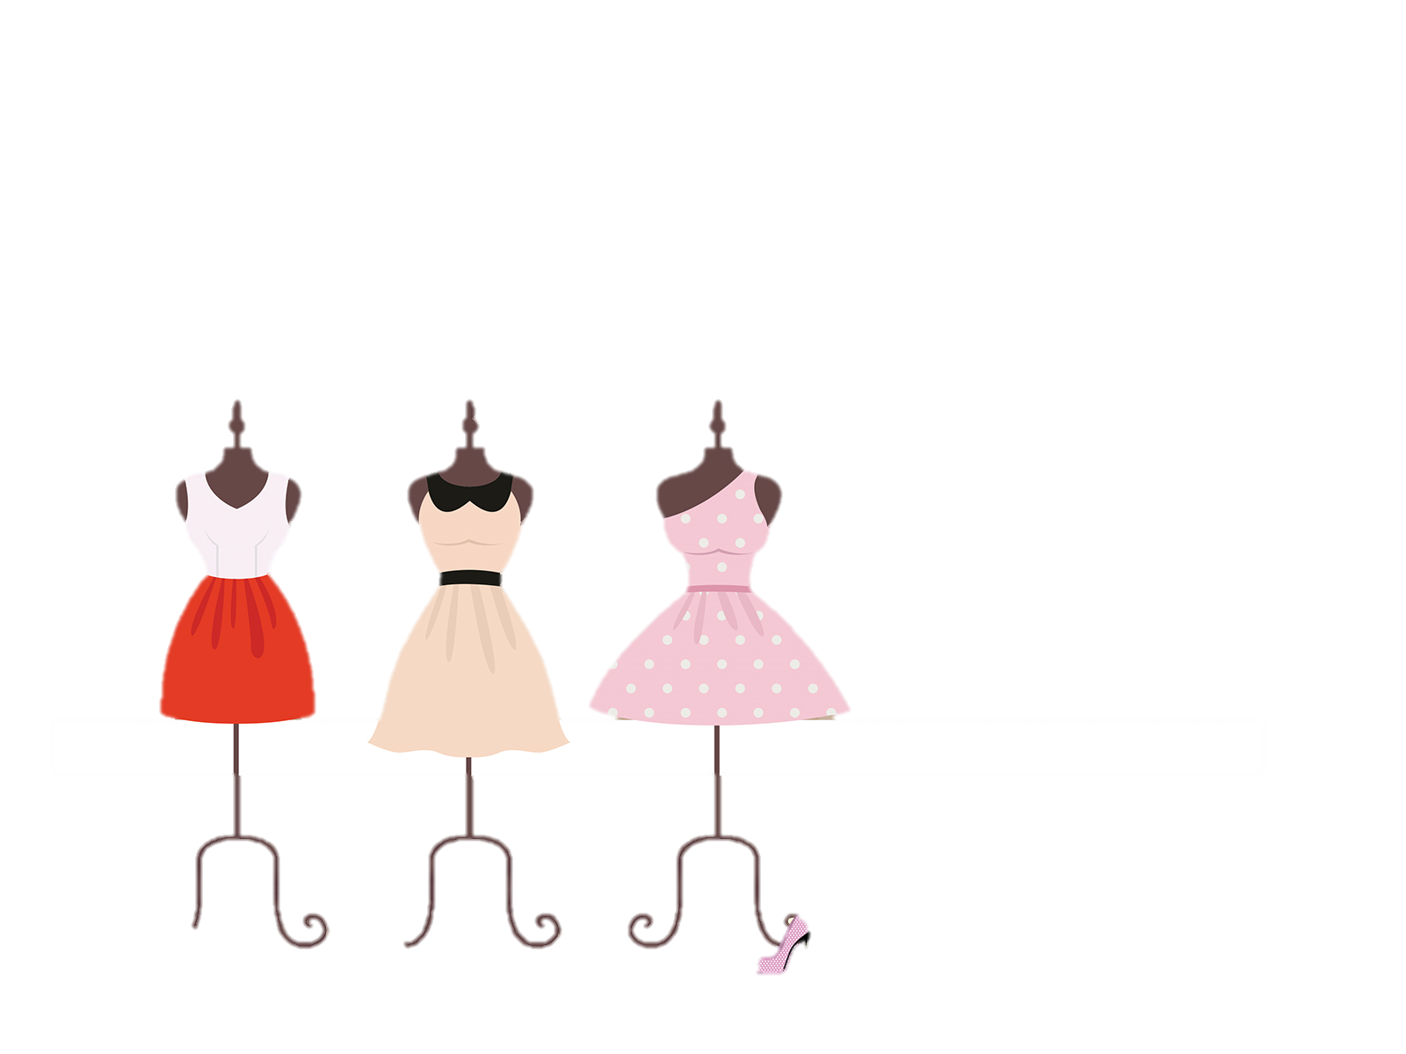
DEEPWEAR

Slide 2
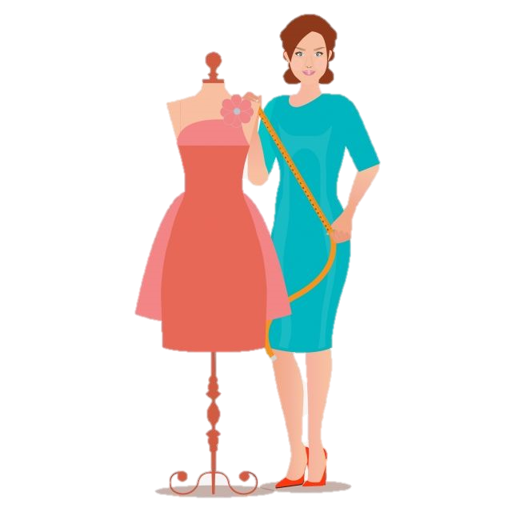
COMPANY OBJECTIVE:
The primary objective of a fashion design company is to consistently create innovative and stylish designs that resonate with its target audience. Focused on establishing a strong brand identity, the company aims to position itself uniquely in the market, maintaining a commitment to quality, craftsmanship, and sustainability

Slide 3
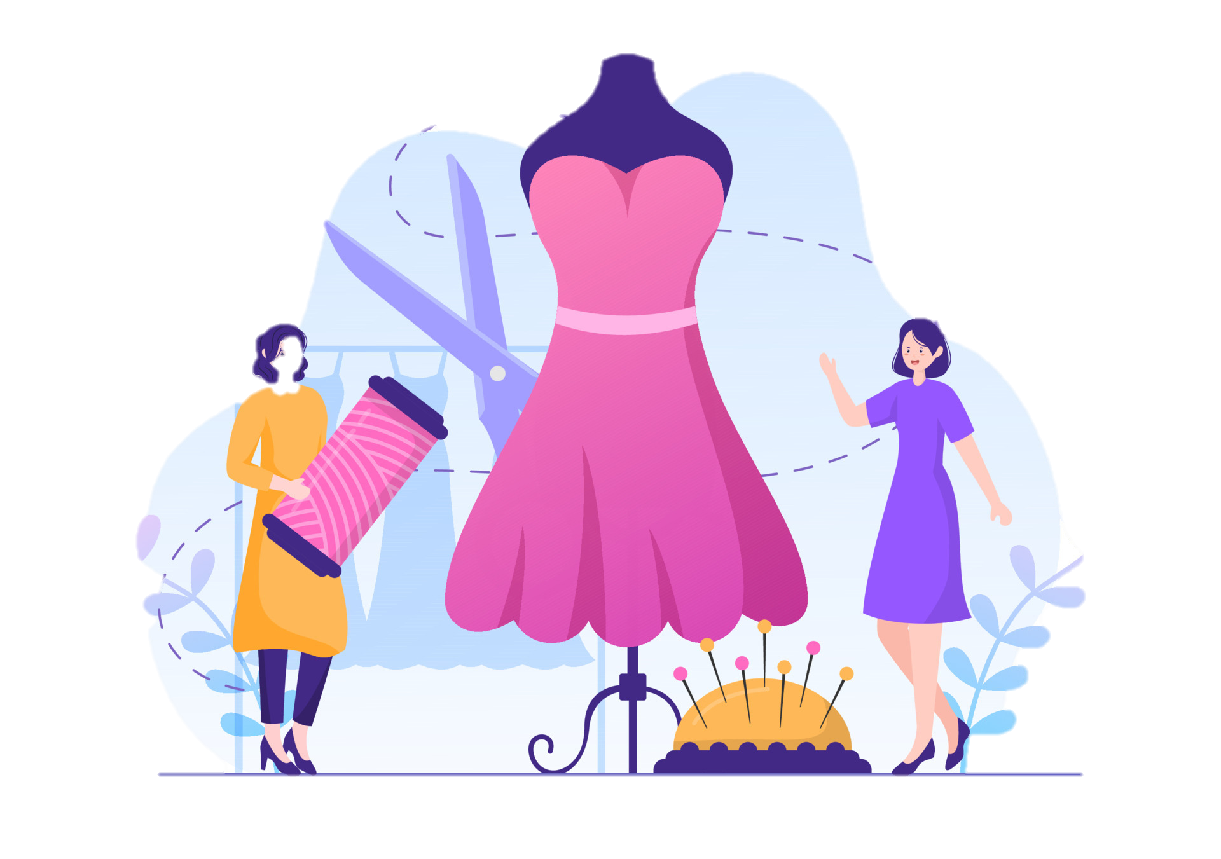
TEAM MEMBERS:
Gulrukh Kashaf (2023F-BSE-280)
a creative professional specializing in textile, Crafting vibrant textiles, blending creativity and functionality to elevate spaces.
Mariam Zuberi(2023F-BSE-261)
a creative professional specializing in interior , Transforming spaces with a blend of aesthetic harmony and practical design solutions.

Slide 4
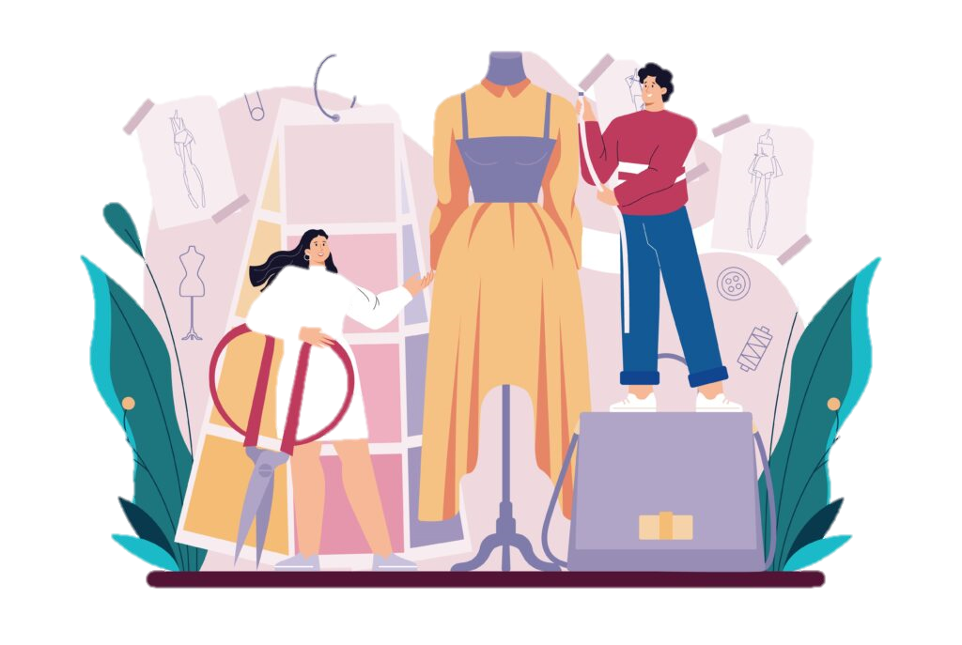
WHAT WE DO
We're a fashion design company, and our job is to create trendy and cool clothing and accessories.
We want people to feel good and express themselves through the stylish and high-quality stuff we make
Our goal is to make fashion fun and accessible for everyone!

Slide 5
OUR TARGET
Make Clothes for Everyone: Create styles that everyone can like, no matter their taste or style.
Be Trendy and Cool: Always have the newest and coolest designs to inspire people.
Quality Matters: Make sure our clothes are well-made and last a long time.
Affordable Fashion: Have a range of prices so that everyone can enjoy our stylish clothes.
Make Customers Happy: Listen to what people want & make sure our customers are happy.
Be Creative: Encourage new ideas and ways of designing to keep things fresh and exciting.
Be a Recognizable Brand: Make our name known and trusted in the fashion world.
Go Global: Share our designs with the world by selling online and teaming up with others.

Slide 6

OUR ARCHIEVEMENTS:
Cool Designs: People love our trendy and cool designs.
Green Fashion: We're known for using eco-friendly materials and practices.
Happy Customers: We have a lot of happy customers who love our products and service.
Big Awards: We won awards for being really good at fashion.
Teamwork: We worked with other cool brands and designers.
Runway Success: Our fashion shows were a big hit, and people loved our collections.

Slide 7
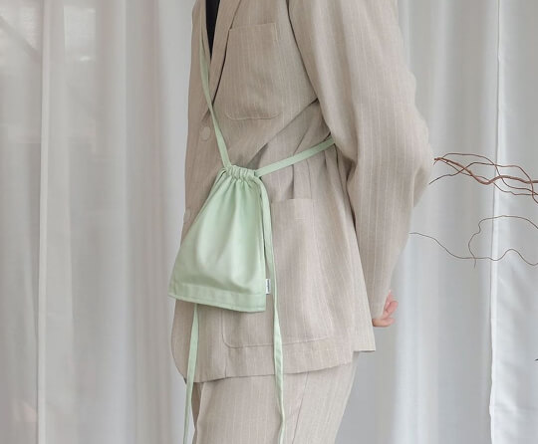
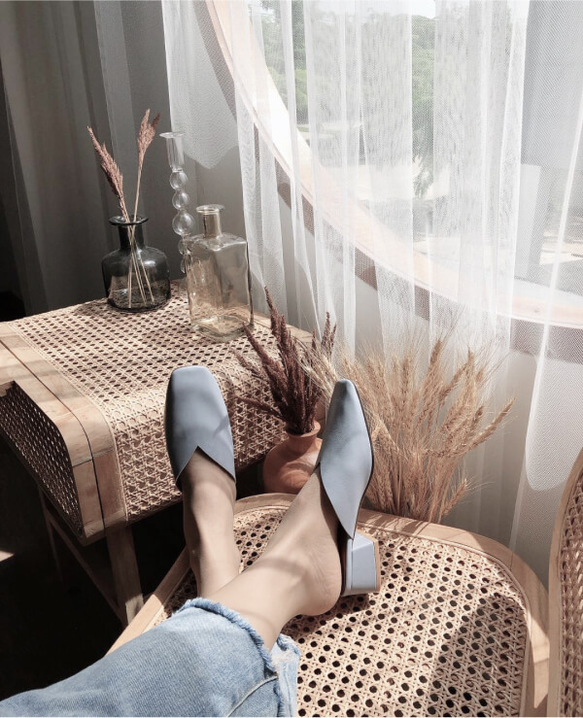
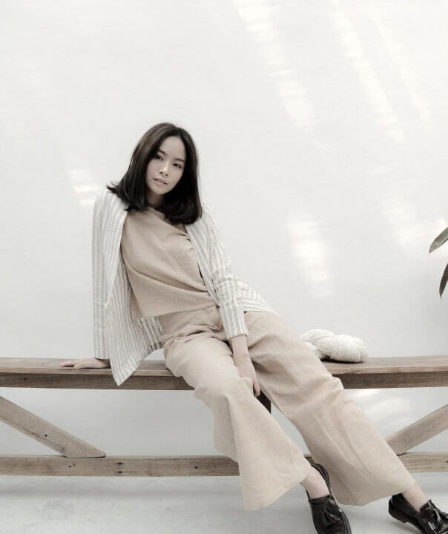
OUR PRODUCT:
Garments
Shoes
Bags

Slide 8
PROFIT AND LOSS:
In the dynamic world of fashion design, managing profit and loss is crucial for our company's success. We carefully balance the costs of creating high-quality, stylish products with the revenue generated from sales. This involves strategic pricing, cost-effective production methods, and staying mindful of market trends.

Slide 9
FINANCIAL:
Revenue Streams:
Apparel Sales: $1 million
Accessories Sales: $1 million
Expense Breakdown:
Cost of Goods Sold (COGS): $100 LACS
Operating Expenses (Marketing, Salaries, Rent, R&D): $1 million
3. Financial Performance:
Gross Profit Margin: 30%
Net Profit Margin: 15%
4. Future Outlook:
Sales Forecasts: 20% growth
Profitability Goals: Achieving 18% margin
5. Investment Opportunities:
Seeking investment for expansion
Utilization of Funds: Marketing (30%), Production (40%), Innovation (30%)
Expected Return on Investment: 25%

Slide 10
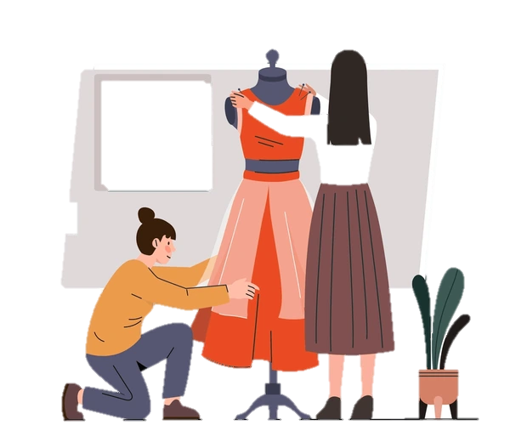
OUR DREAMS:
Setting Trends: Dreaming of creating popular styles that everyone loves and wants to wear.
Being Eco-Friendly: Dreaming of making clothes in a way that's good for the environment.
Global Influence: Wanting people all around the world to know and like our designs.
Celebrating Diversity: Dreaming of making clothes that people from all backgrounds can enjoy.
Positive Legacy: Dreaming of leaving a positive mark in the fashion world and beyond.

Slide 11
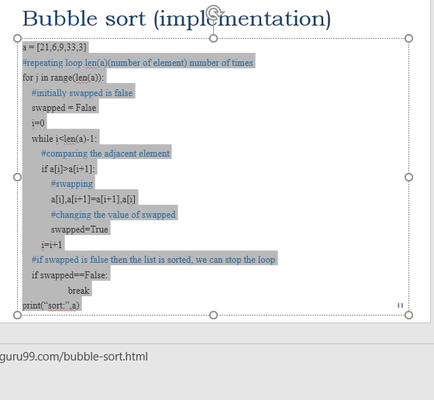

COLLABORATE WITH US
We're thrilled to propose a collaborative venture between our fashion design company and yours. Combining the unique styles and strengths of both brands, we envision an innovative partnership that pushes creative boundaries. Our shared passion will drive the creation of exclusive collections, promising mutual benefits and expanded market reach. This collaboration aims to captivate the fashion-forward audience with fresh, trendsetting designs. Let's embark on this exciting journey together, shaping the future of fashion.
Contact us at DEEPWEAR@gmail.com

